Slide 1

Concurrency
State Models and Java Programs
Jeff Magee and Jeff Kramer

Slide 2
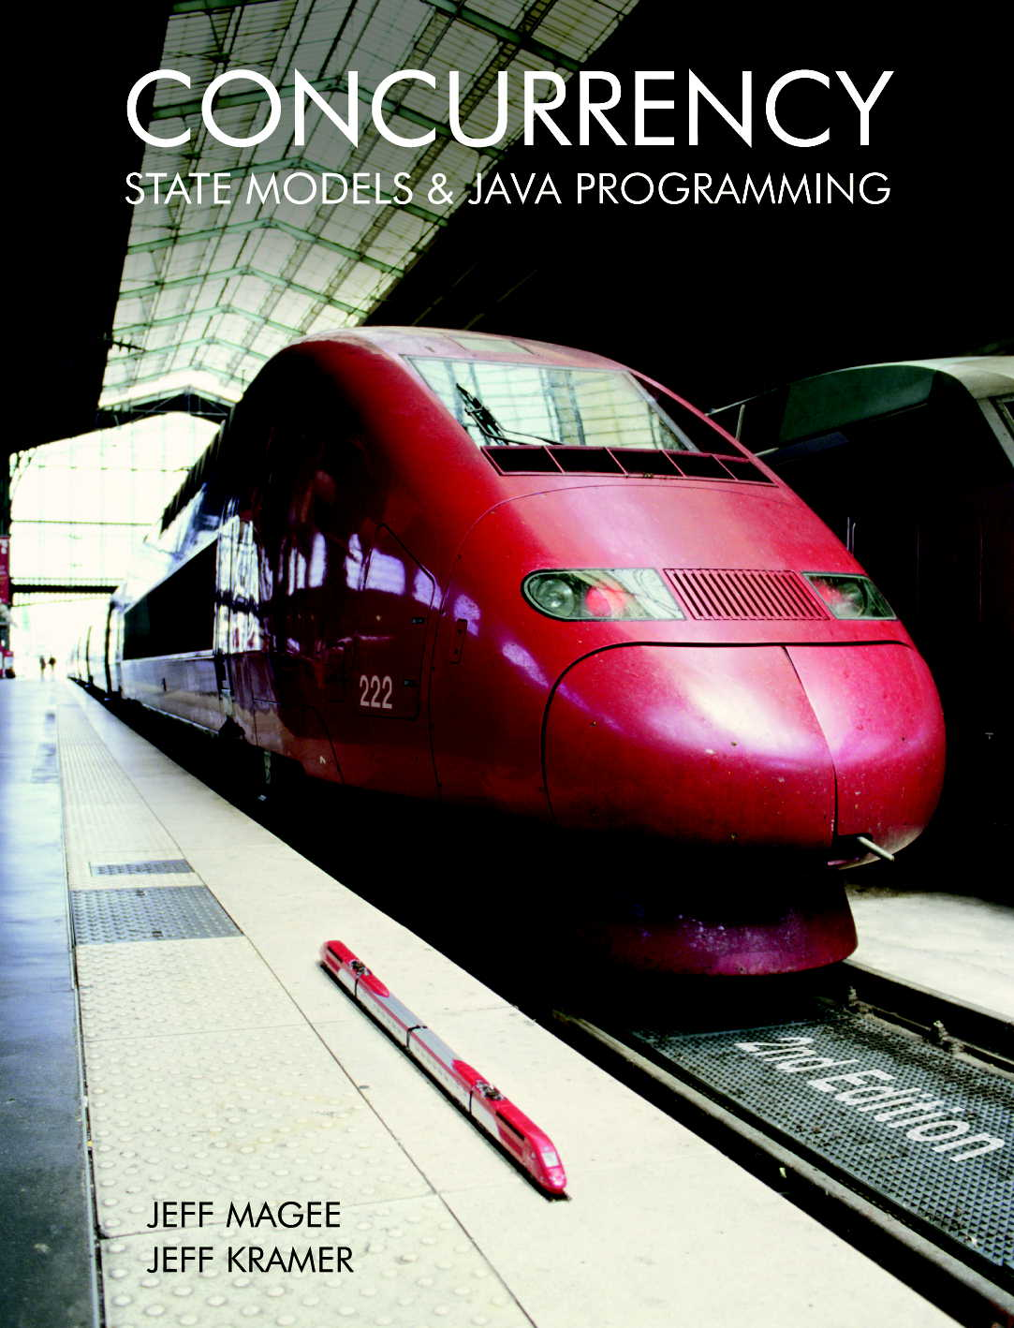
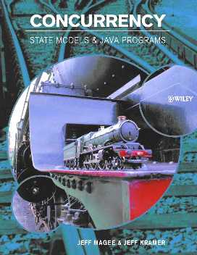
Book
Concurrency:
State Models &
Java Programs,
2nd Edition
Jeff Magee &
Jeff Kramer
WILEY
1st edition

Slide 3
Course Outline
Processes and Threads
Concurrent Execution
Shared Objects & Interference
Monitors & Condition Synchronization
Deadlock
Safety and Liveness Properties
Model-based Design
Dynamic systems
Message Passing
Concurrent Software Architectures
The main basic
Concepts
Models
Practice
Advanced topics …
Timed Systems
Program Verification
Logical Properties

Slide 4
Web based course material
http://www.wileyeurope.com/college/magee
http://www.doc.ic.ac.uk/~jnm/book/
Java examples and demonstration programs
State models for the examples
Labelled Transition System Analyser (LTSA) for modeling concurrency, model animation and model property checking.

Slide 5
What is a Concurrent Program?
A sequential program has a single thread of control.
A concurrent program has multiple threads of control allowing it perform multiple computations in parallel and to control multiple external activities which occur at the same time.

Slide 6
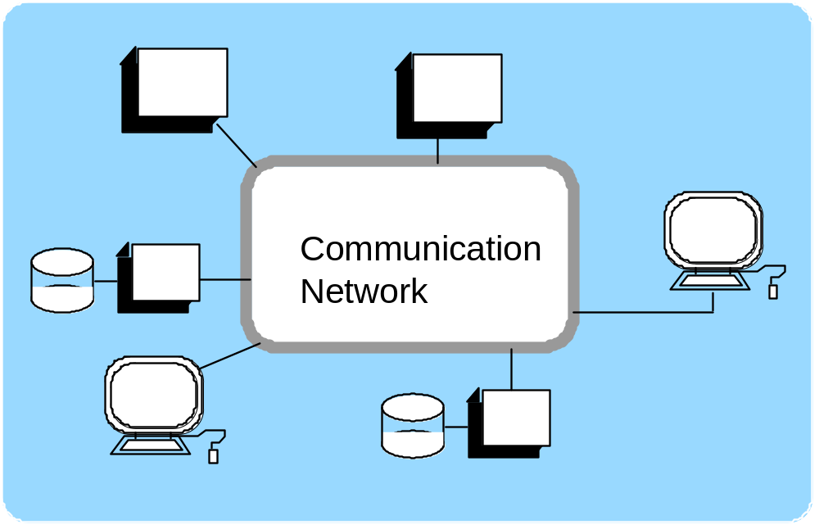
Concurrent and Distributed Software?
Interacting, concurrent software components of a system:
single machine -> shared memory interactions
multiple machines -> network interactions

Slide 7
Why Concurrent Programming?
Performance gain from multiprocessing hardware
  parallelism.
Increased application throughput
  an I/O call need only block one thread.
Increased application responsiveness
  high priority thread for user requests.
More appropriate structure
  for programs which interact with the environment, control multiple activities and handle multiple events.

Slide 8
Do I need to know about concurrent programming?
Concurrency is widespread but error prone.
Therac - 25 computerised radiation therapy machine
  Concurrent programming errors contributed to accidents causing deaths and serious injuries.
Mars Rover
  Problems with interaction between concurrent tasks
  caused periodic software resets reducing availability for
  exploration.

Slide 9
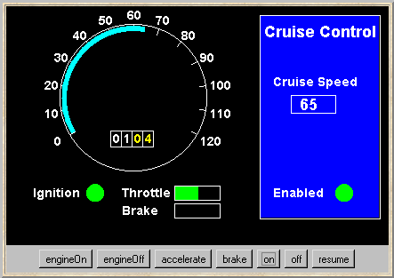
a Cruise Control System
When the car ignition is switched on and the on button is pressed, the current speed is recorded and the system is enabled: it maintains the speed of the car at the recorded setting.
Pressing the brake, accelerator or off button disables the system. Pressing resume re-enables the system.
buttons
Is the system safe?
Would testing be sufficient to discover all errors?

Slide 10
models
A model is a simplified representation of the real world.
Engineers use models to gain confidence in the adequacy and validity of a proposed design.
focus on an aspect of interest - concurrency
model animation to visualise a behaviour
mechanical verification of properties (safety & progress)
Models are described using state machines, known as Labelled Transition Systems LTS. These are described textually as finite state processes (FSP) and displayed and analysed by the LTSA analysis tool.

Slide 11
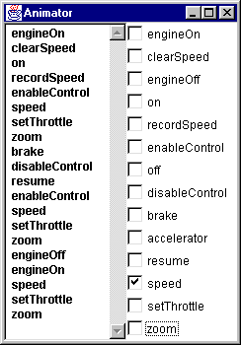
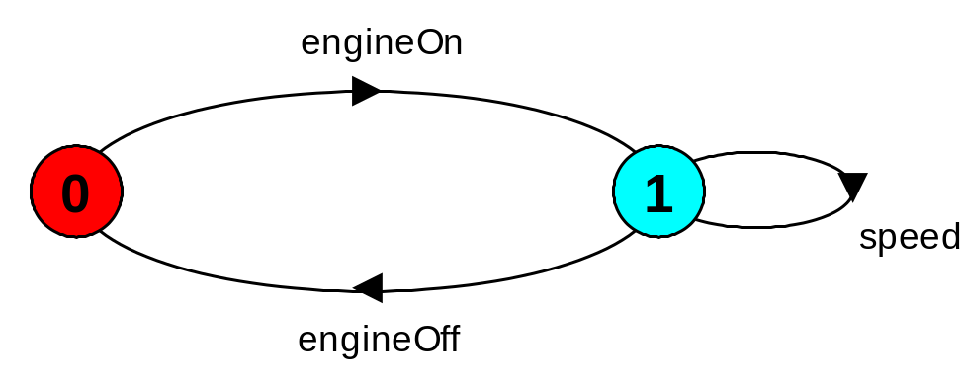
modeling the Cruise Control System
LTSA Animator to step through system actions and events.
LTS of the process that monitors speed.
Later chapters will explain how to construct models such as this so as to perform animation and verification.

Slide 12

programming practice in Java
Java is
widely available, generally accepted and portable
provides sound set of concurrency features
Hence Java is used for all the illustrative examples, the demonstrations and the exercises. Later chapters will explain how to construct Java programs such as the Cruise Control System.
“Toy” problems are also used as they exemplify particular aspects of concurrent programming problems!

Slide 13
course objective
This course is intended to provide a sound understanding of the concepts, models and practice involved in designing concurrent software.
The emphasis on principles and concepts provides a thorough understanding of both the problems and the solution techniques. Modeling provides insight into concurrent behavior and aids reasoning about particular designs. Concurrent programming in Java provides the programming practice and experience.

Slide 14
Summary
Concepts
  we adopt a model-based approach for the design and construction of concurrent programs
Models
  we use finite state models to represent concurrent behavior.
Practice
  we use Java for constructing concurrent programs.
Examples are used to illustrate the concepts, models and demonstration programs.

